Slide 1


RESULT SUBMISSION
Faculty Portal CMS

Slide 2
How to access CMS?
How to login?
How to submit result.
<number>

Slide 3
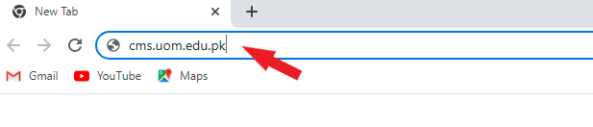
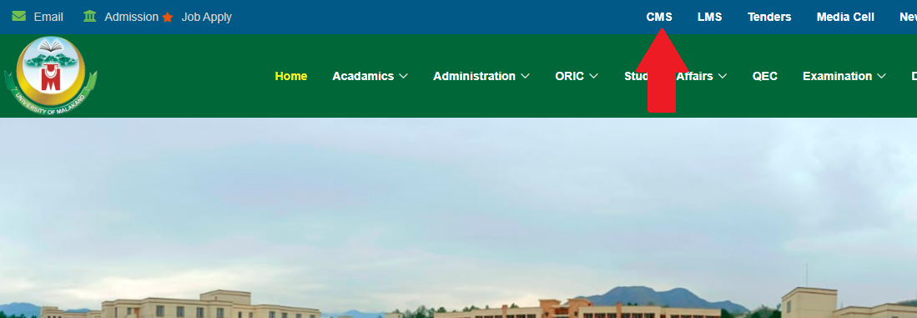
How to access CMS?
There are two options to access the CMS through URL or through university website.
Through URL
Open a web browser (Google Chrome, Firefox, Microsoft Edge) whatever you use. When a browser is open type the following URL:
cms.uom.edu.pk
Through University website
Open university website, click on CMS in the top menu, it will navigate you to the login page.
<number>

Slide 4
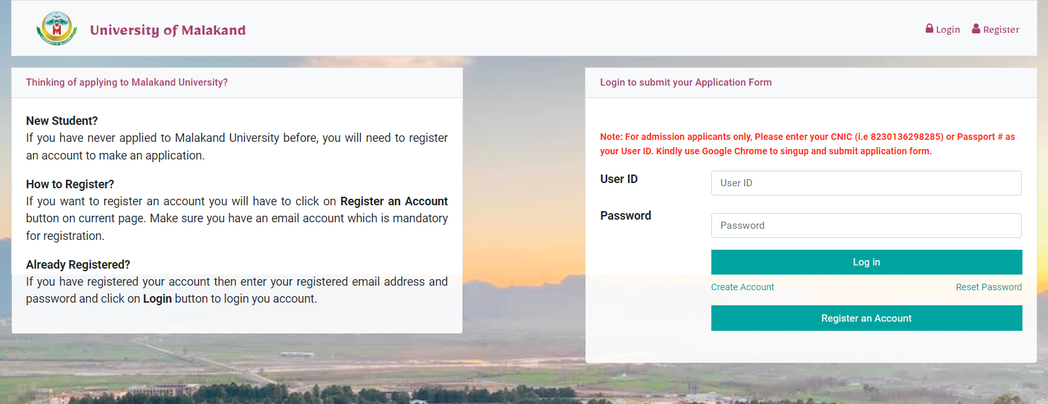
How to log in?
After typing the URL or Click on CMS in website you will see the following page which contains the login form enter your user id and password and click on the login button.
<number>

Slide 5
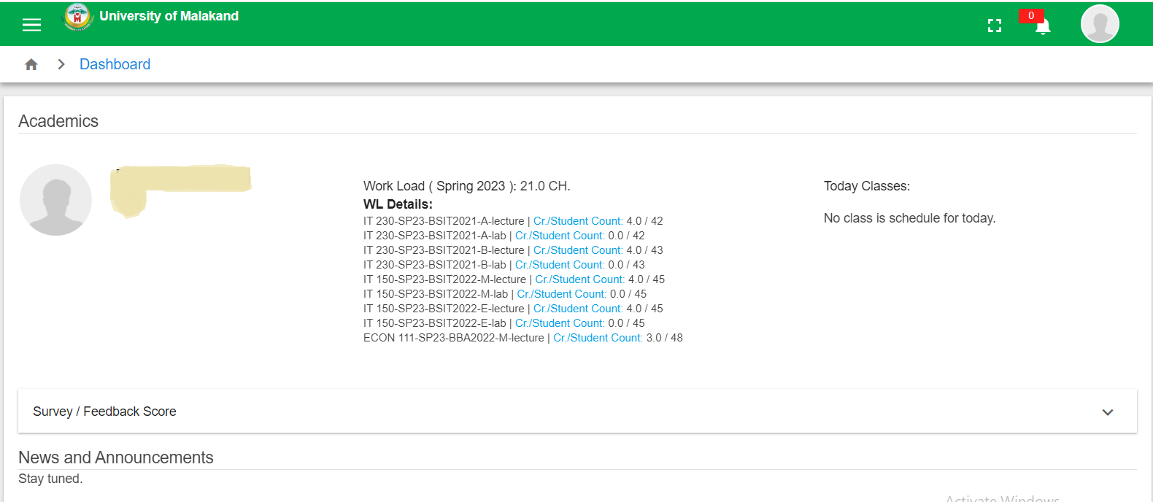
Faculty Portal
After login to the portal, the following interface will appear.
<number>

Slide 6
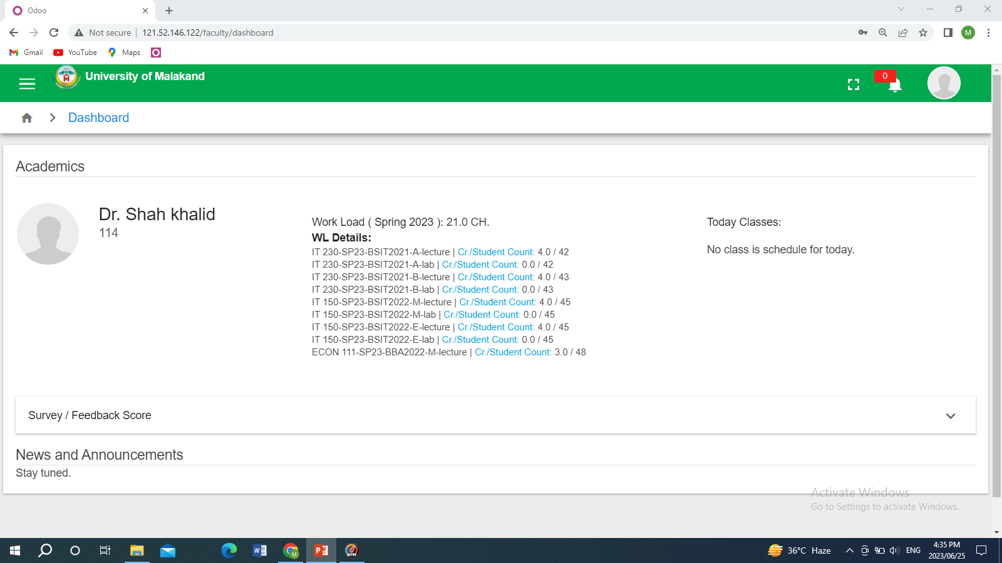
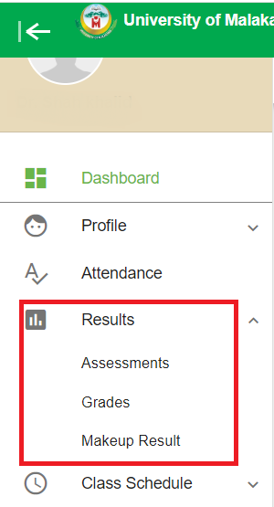
How to submit result?
Assessments
Grades
To submit the result Click on the sidebar menu which contains tab Result.
Menu Button
<number>

Slide 7
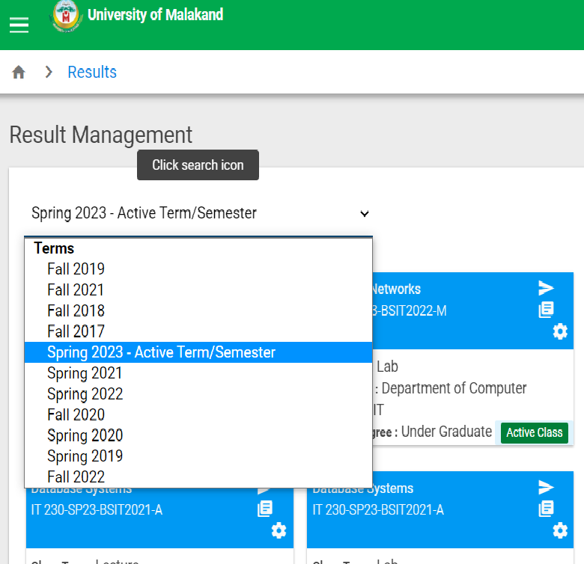
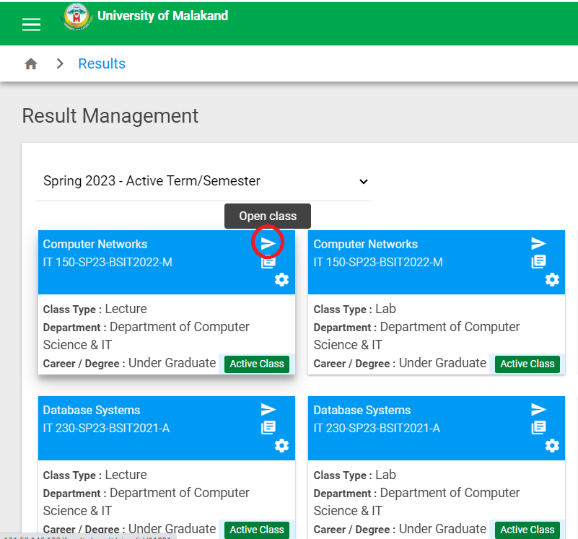
Assessments
After clicking on the result tab, The first option is assessment menu present under result tab click on it. Assessment menu is used for marks entry where faculty enter subject marks. It contains courses for current semester and previous semester as well. Search option is provided on a term basis where faculty search courses of a different term. To enter a marks click on open class button.
Open Class button
<number>

Slide 8
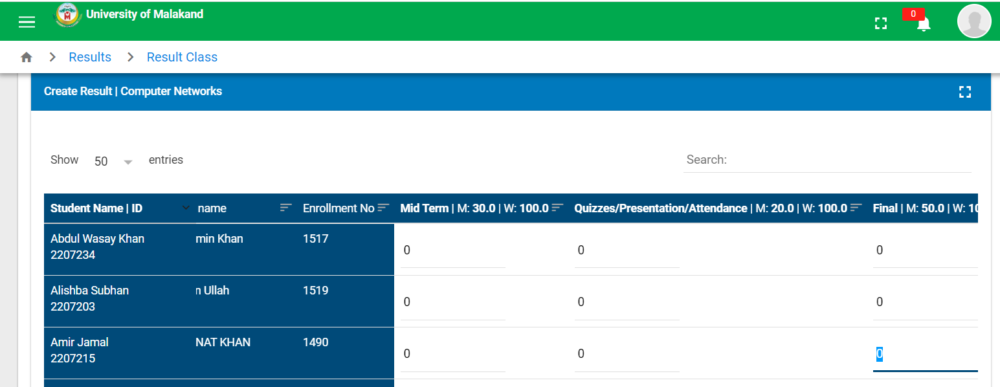
After open class this interface is show to faculty which contain students name with registration and enrollment Number and also fields for marks entry.
<number>

Slide 9
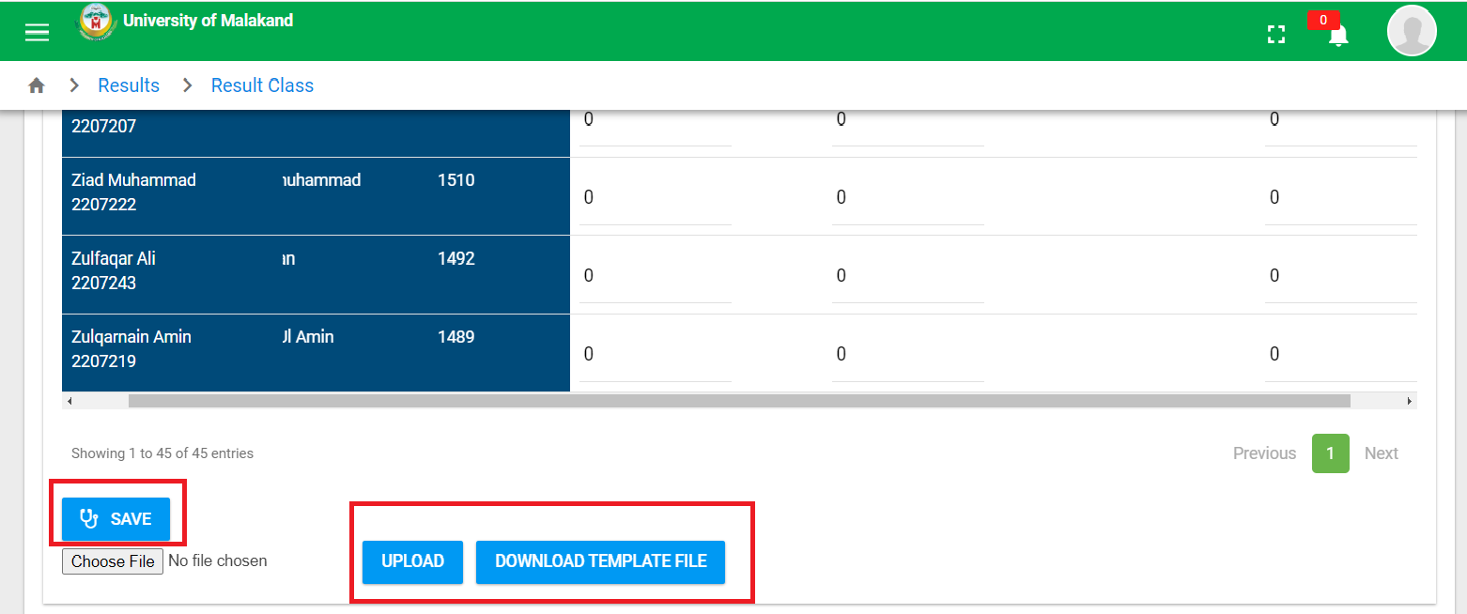

The system provides two options either enter marks directly or download an Excel sheet. To enter marks in the Excel sheet click on the Download template file button which downloads the template file enters the marks in the file and saves it. Then click on Choose File choose the file in which you enter marks and then click on the upload button. After completion of marks entry click on the save button.
Note
The system gets the marks from the Excel sheet based on the registration number if the registration number is not assigned to the students then this option doesn't work.
<number>

Slide 10
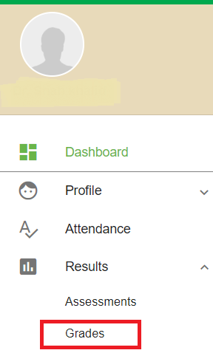
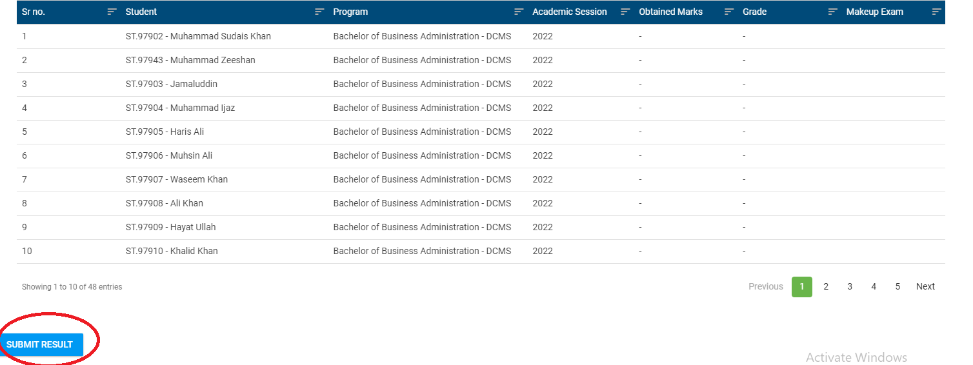
Grades
After saving marks, navigate to the Grades menu which contain students' percentage and grades. When faculty save marks the system automatically assigns grades to students. Faculty need to check if the percentage and grades are correct Click on SUBMIT RESULT BUTTON your result will be submitted to the HOD/Chairman.
<number>

Slide 11
Thank You

